Slide 1
Introduction to e-Commerce
Day 7

Slide 2
What is e-Commerce
Commerce is a division of trade or production which deals with the exchange of goods and services from producer to final consumer
It comprises the trading of something of economic value such as goods, services, information, or money between two or more entities.
Business that is transacted by transferring data electronically, especially over the Internet.
It consist of buying and selling goods and services over an electronic systems such as the internet and other computer networks.
Commerce
E-Commerce

Slide 3
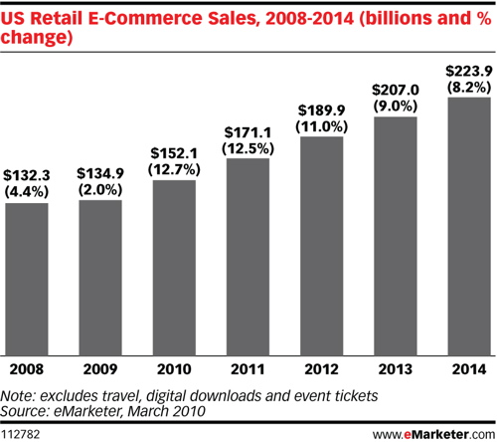
Main Advantages of e-Commerce
One of the best Advantages e-commerce has is to Overcome Geographical Limitations. If you have a physical store, you are limited by the geographical area that you can service. With an ecommerce website, the whole world is your playground.
The advent of m-commerce, i.e. e-commerce on mobile devices, has dissolved every remaining limitation of geography.
Another advantage that E Commerce has is Remain Open All the Time. Now stores are open 24/7/365. Ecommerce websites can run all the time. From the merchant's point of view, this increases the number of orders they receive. From the customer's point of view, an "always open" store is more convenient. This 24/7 idea makes consumers feel as if they can buy what they want when they want.

Slide 4
Brief History of e-Commerce
1970s: Electronic Funds Transfer (EFT)
Used by the banking industry to exchange account information over secured networks
Late 1970s and early 1980s: Electronic Data Interchange (EDI) for e-commerce within companies
Used by businesses to transmit data from one business to another
1990s: the World Wide Web on the Internet provides easy-to-use technology for information publishing and dissemination
Cheaper to do business (economies of scale)
Enable diverse business activities (economies of scope)

Slide 5
E-Commerce Process
A consumer uses Web browser to connect to the home page of a merchants Web site on the Internet.
The consumer browses the catalog of products featured on the site and selects items to purchase.
The selected items are placed in the electronic equivalent of a shopping cart.
When the consumer is ready to complete the purchase of selected items (checkout), s/he provides a bill-to and ship-to addresses for purchase and delivery.
When the merchant’s Web server receives this information, it computes the total cost of the order-- including tax, shipping, and handling charges--and then displays the total to the customer.
The customer can now provide payment information, such as a credit card number, and then submit the order.
When the credit card number is validated and the order is completed at the Commerce Server site, the merchants site displays a receipt confirming the customers purchase.
The Commerce Server site then forwards the order to a Processing Network for payment processing and fulfillment.

Slide 6
Types of e-Commerce
B2B stands for Business to Business. It constitutes the largest form of e-commerce. This model defines that Buyer and seller are two different entities. It is similar to manufacturer issuing goods to the retailer or wholesaler.
Example: Dell electronically buys computer parts from other manufacturers (Intel, Toshiba etc.) in order to assemble and sell Dell laptops.
It is the model involving businesses and consumers interaction. The basic concept of this model is to sell the product online to the consumers.
B2c is the direct trade between the company and consumers. It provides direct selling through online sales channel.
When we (consumers) shop online it is the B2C type of e-Commerce.
B2B
B2C

Slide 7
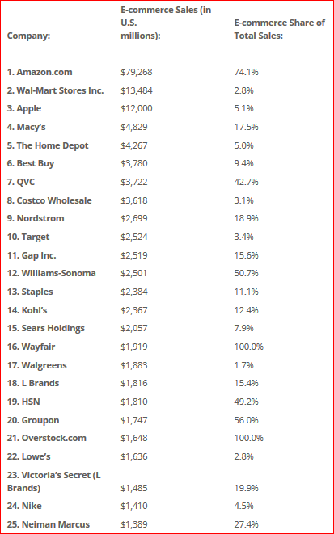
Top e-Commerce Sites
Top US e-Commerce sites by sales, according to the CEO World magazine, 2016 http://ceoworld.biz/2016/03/08/americas-top-25-e-commerce-retailers-sales

Slide 8
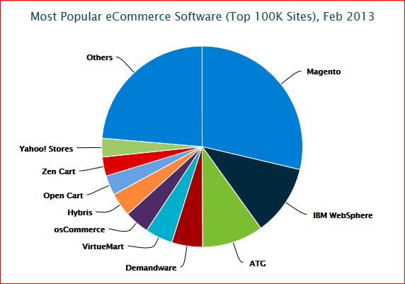
Top B2C e-Commerce Software
https://tomrobertshaw.net/2013/03/feb-2013-ecommerce-survey/?icid=BLOG_alexatopplatform_robertshawfeb2013report

Slide 9
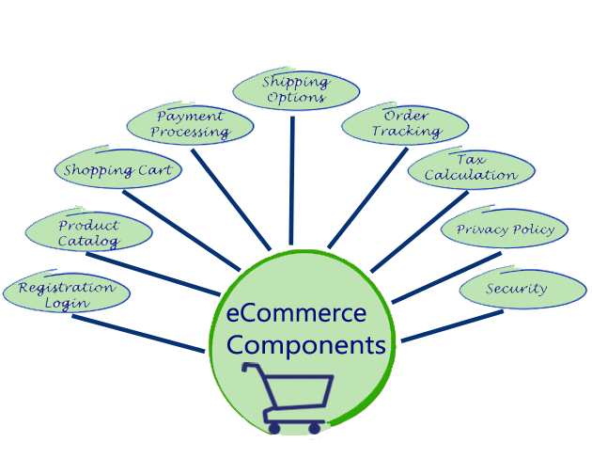
Main Functional Components of e-Commerce Software
https://www.onestop-webshop.co.uk/guide-to-selling-online

Slide 10
Magento Architectural Principles
OOP architecture and programming principles
Object-Oriented Programming (OOP) design allows for maximum flexibility and extensibility of software components, permitting you to design and implement highly customized web sites. The advantages of OOP principles include incorporation of industry-standard programming design patterns and the strict separation of business logic from presentation. Object inheritance is important, too: in keeping with classic object-oriented programming methodology, the Magento platform provides core components with base functionality that can be inherited by custom components for a specific web site or application.

Slide 11
Magento Architectural Principles
Strongly layered product architecture
This supports the separation of visual presentation from business logic. This compartmentalization simplifies customization of store appearance and behavior. Architectural layers also provide programmers with a high level-model for understanding the optimal placement of features and code in a complex system. Magento tweaks the classic Model-View-Controller architectural model, though: files within modules are typically grouped by functionality rather than file type.
The Magento Framework defines the fundamental concepts and rules for how the components of the web site can behave. The Magento framework contains libraries that modules access but no business logic components. It accepts HTTP requests and routes them to the appropriate module.

Slide 12
Magento Architectural Principles
Integration with architectural layers
Presentation layer - The Presentation layer provides both view components (layouts, blocks, templates) and controllers, which process commands to and from the user interface. The presentation layer can also include web API service bindings. (We include these service bindings in this discussion of the presentation layer model because web API calls come in through HTTP just like browser requests, and can be made via AJAX calls from the user interface. Consequently, while web API calls can originate from an external application, they can also originate from the user interface.)
Service layer - Through the use of service contracts, the Service layer defines the overall interface for interacting with business logic (for example, creating customers and getting tax rates). Service contracts simplify the process of replacing or modifying (via plugins) services.
Domain layer - The Domain layer (also referred to as the Business Logic layer) provides core business logic and functionality in base classes, resource models, and data access capabilities that you can extend and customize. Business logic rules, which define how data is retrieved from the database and manipulated, are stored in the Domain layer.

Slide 13
Magento Architectural Principles
Ease of extensibility
Magento uses dependency injection and service contracts to simplify the process of supplying a new implementation of a defined API.
Dependency injection benefits include:
the client that uses a module or service can remain ignorant of the module’s or service’s implementation details
you can modify a module without altering the client from anywhere you use the dependency injection framework to wire application logic together.
Service Contracts provide a new way to access public API endpoints. These PHP interfaces to modules streamline the use of APIs for most modules.

Slide 14
Magento Architectural Principles
Modularity
A module is a basic functional unit of a Magento system. Magento modules contain the logic to execute required actions and functions. You extend the core feature set of Magento by writing and incorporating new modules into your installation. Use Magento themes and language packages to create your store’s visual design and language capabilities.
Highly customizable store branding
Extend and customize the core components of your Magento store’s PHP-, HTML5- and CSS3- based default themes and language packages to precisely control your site’s behavior and look-and-feel.
Strong stack of open-source technologies
The Magento tech stack supplies a robust toolset for deploying large, distributed storefronts and for customizing the product for your particular needs. The Magento stack includes popular open-source technologies such as the Linux or Windows OS, Apache/Nginx server, MySQL, Zend, and Composer.

Slide 15
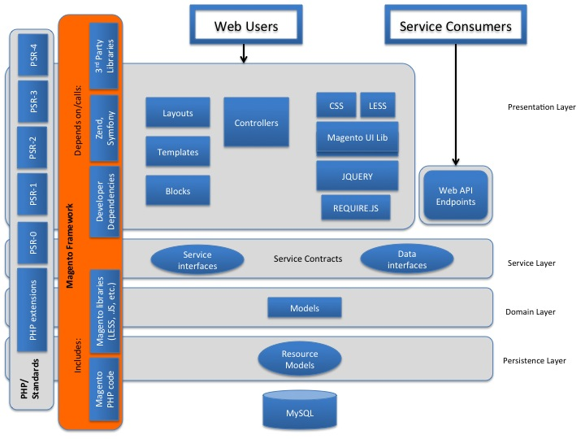
Magento Architecture

Slide 16
Exercise
Download and install Magento Commerce Community Edition
Download link: https://magento.com/tech-resources/download
WAMP installation instructions: http://insync.co.in/how-to-install-magento-on-wamp-server-localhost-localcomputer/
Make sure you can open both the store front and administration panel in the browser.

